Slide 1


Slide 2

Splash Screen

Slide 3
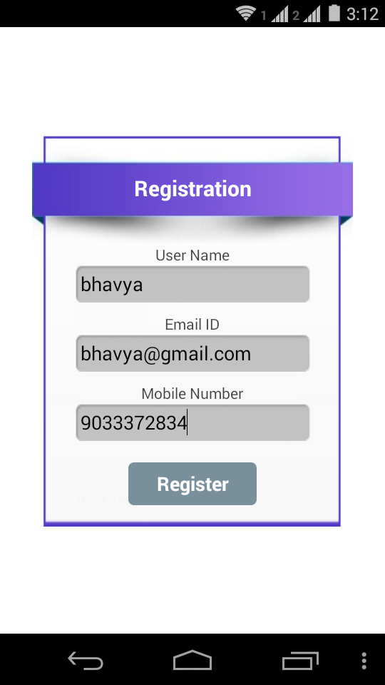
Registration
Registration Screen will appear after Splash screen
over.
All the field are required to fill compulsory.

Slide 4
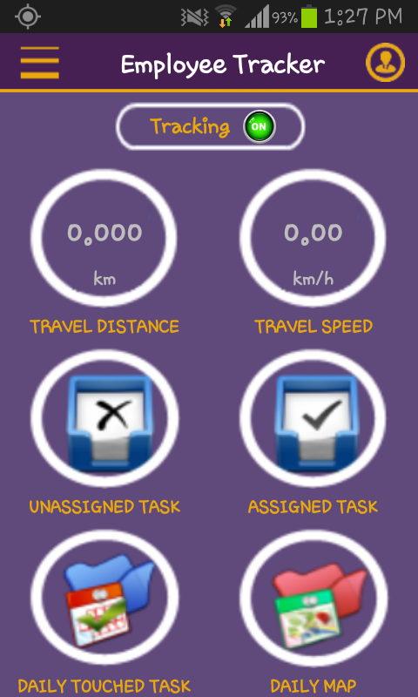
Home Screen

Slide 5
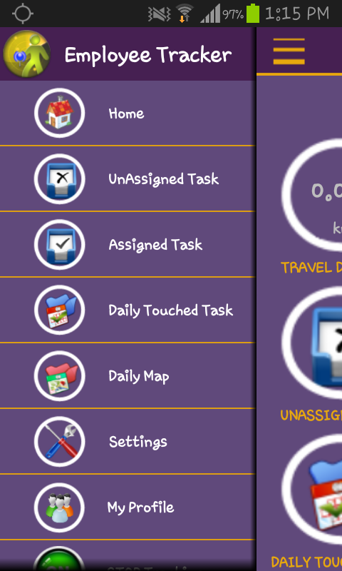
Sliding Menu

Slide 6
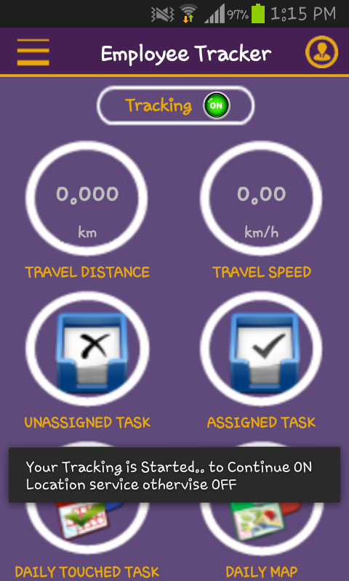
Tracking - On
It will appear when Tracking is On.
Tracking OFF appear Red.
and one message should be appeared to you service started

Slide 7
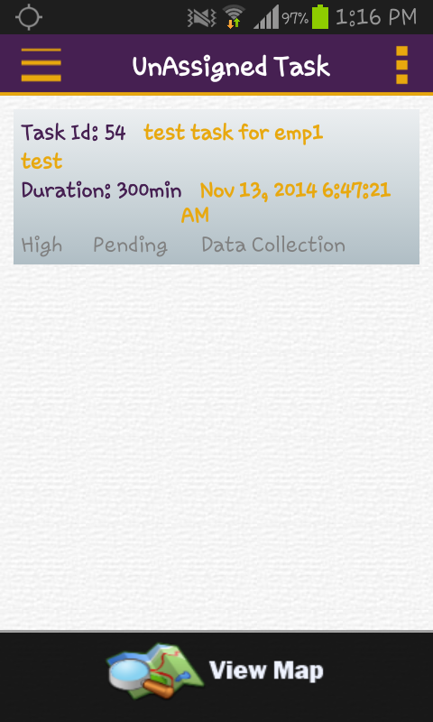
Un Assigned Task
List of UnAssigned Task appear.
Un Assigned are those task that are not Assigned to another employee or employee who leaved task

Slide 8
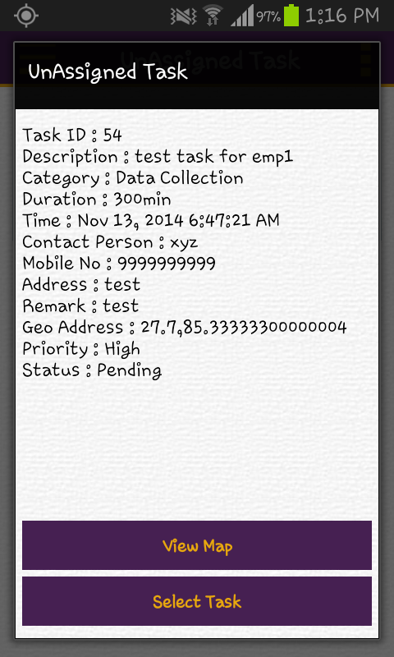
Un Assign Task - Detail
Detail Description of each task can be given.
View Map show the exact location at where task
Should be drop.
Select task move from Un Assign to Assign task list.

Slide 9
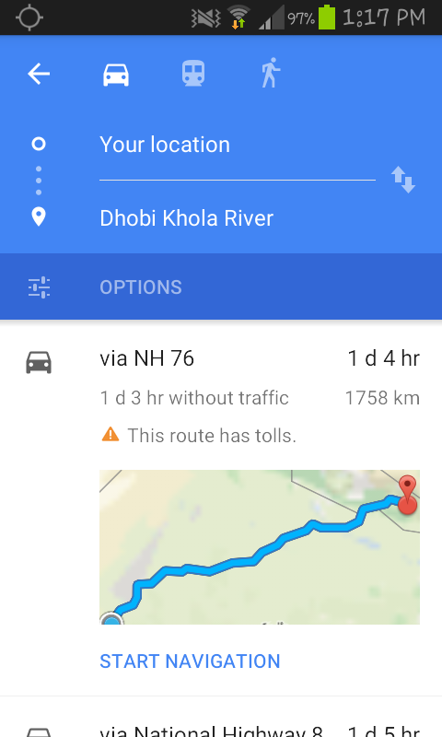
Un Assign Task – View Map
It will navigate from current location to Destination.
With the Google Map API provide functionality to get tha information via Car, Bus and Walking

Slide 10
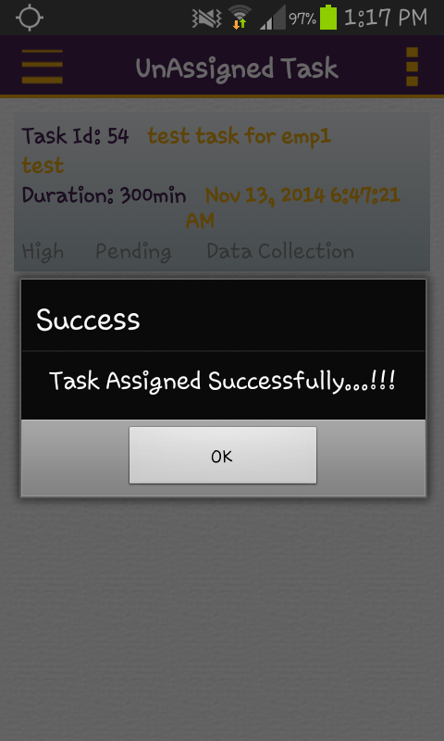
Un Assign Task – Select Task
Un Assign task are those task that can not assigned yet or employee who should left the task.
That can be selected and it will be moved into Unassigned task to Assigned task.

Slide 11
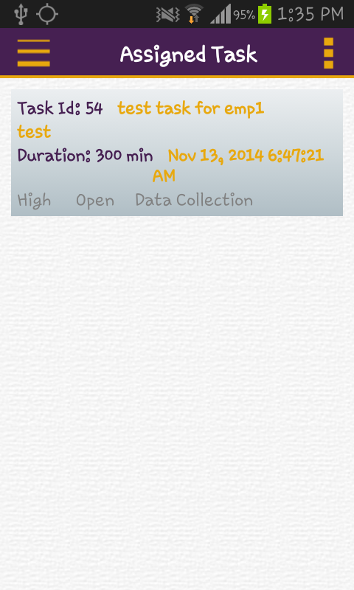
Assigned Task
List of Assigned task that can be assigned to Employee
Task with its ID, Duration, Date and also its priority and status information

Slide 12
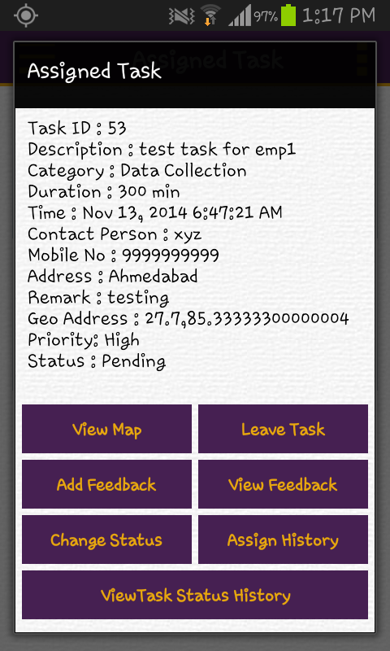
Assigned Task - Detail
Assign Task with its options.
Briefly describe into later slides.

Slide 13
Assigned Task – View Map
Navigate path between current Location to Destination where task should be allocated.

Slide 14
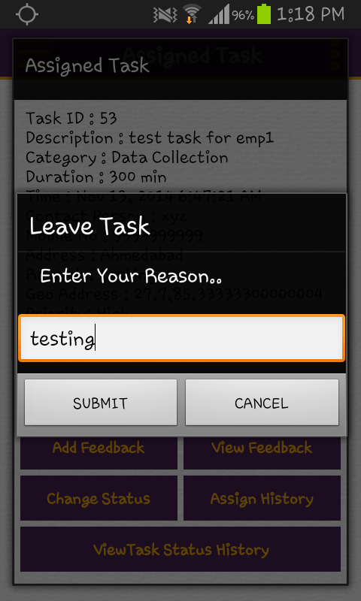
Assigned Task – Leave Task
If Employee should leave the task then one dialog shoule be aappear.
in which Reason must be entered to leave the task.

Slide 15
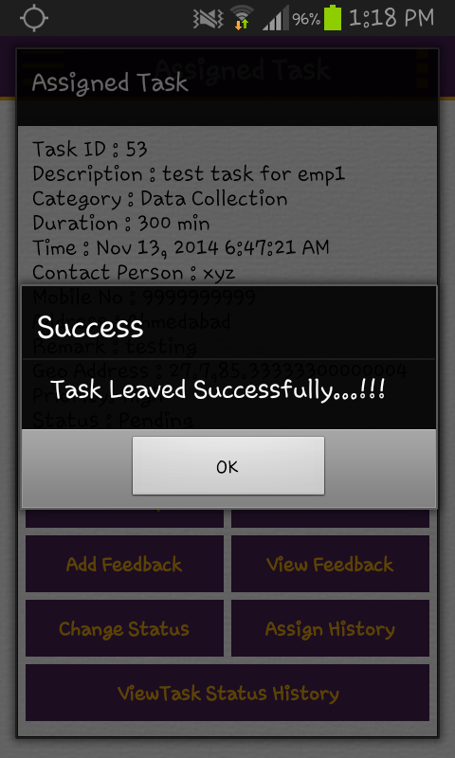
Assigned Task – If Leave Task succesful
If task leaved succesfully then message should appear on the screen.
like “Task Leaved Suucesfully..”

Slide 16
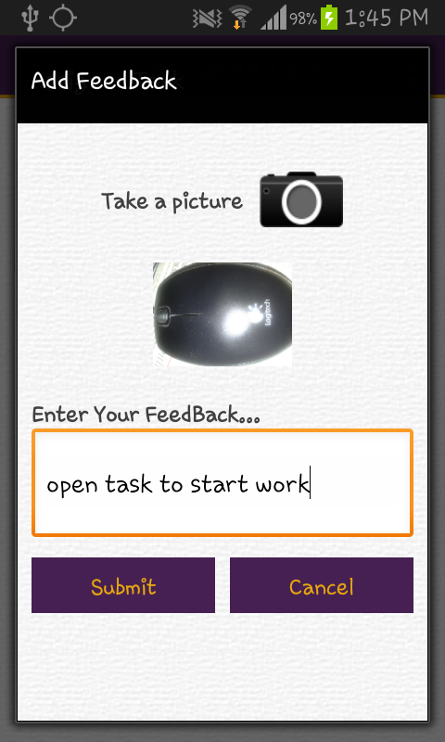
Add Feedback
Click on ‘Take a Picture’ it will open camera device and taken a picture for a feedback
Feedback can be given as a Image as well as Text and also Both should be possible

Slide 17
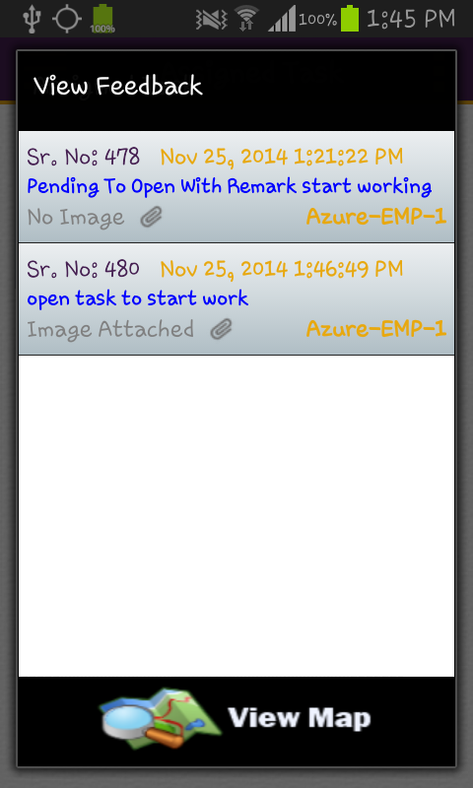
View Feedback List
List of Feedback that can be given by employee
View map can display the map on location from
Where feedback should be given
Display all locations from where Feedback given

Slide 18
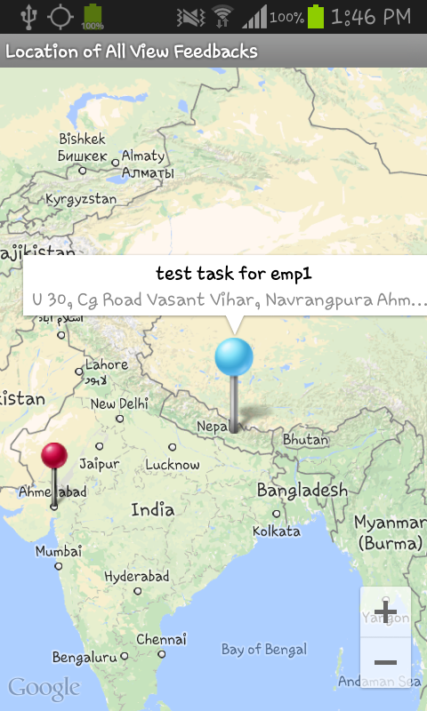
View Feedback - Map
Blue Marker can show the Location of Task
Red Marker shows the location where feedback should be given.

Slide 19
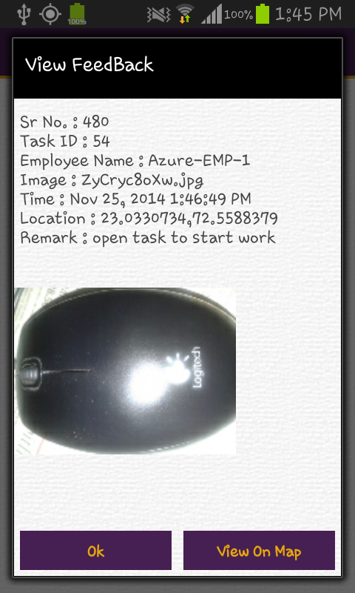
View Feedback
on Perticular list click it will display all information into window
and also display Image that can be put as a time of giving the feedback.

Slide 20
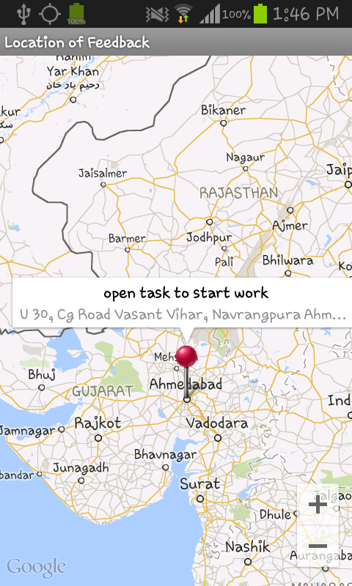
View Feedback – View on Map
That will display perticular feedback location

Slide 21
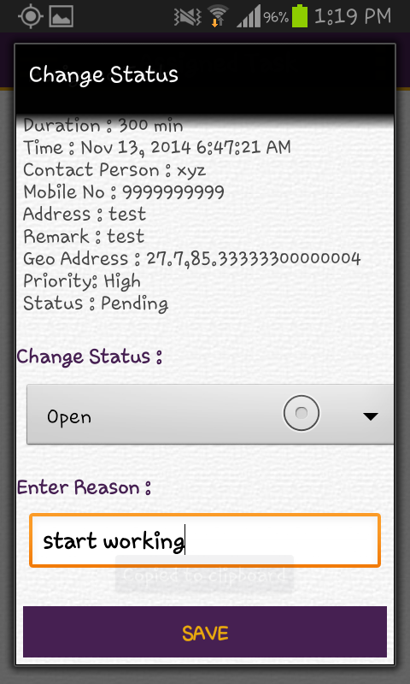
Change Status
Employee can change the status of task
like Open, Onhold, Ongoing, Close
With reason it will be entered.

Slide 22
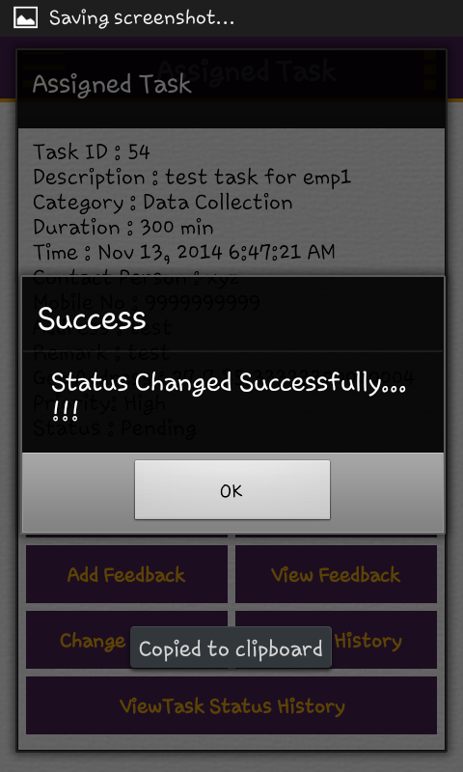
Change Status - Succesful

Slide 23
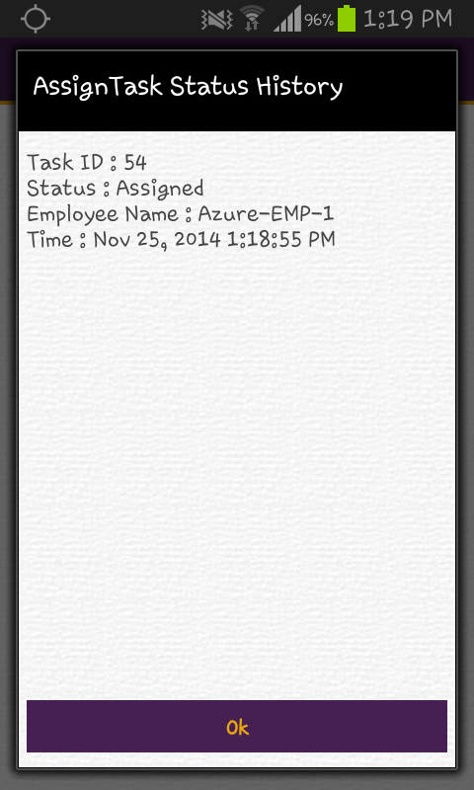
Assign Task Status History

Slide 24
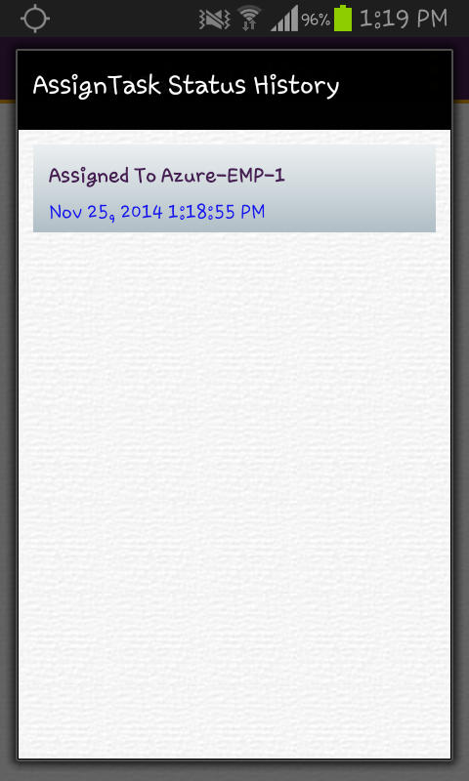
Assign Task Status History - List

Slide 25
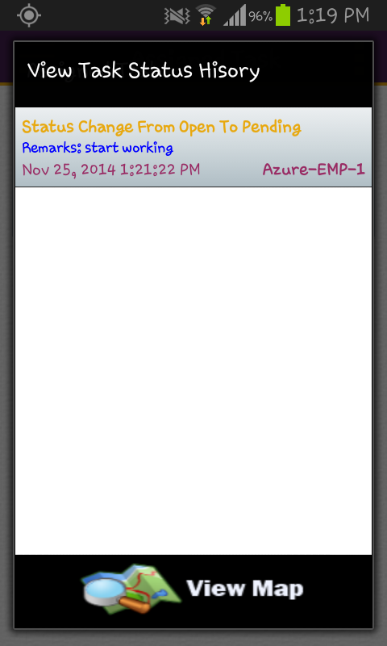
View Task Status History - List
It will be appear when any task status can be change.
like Open to Close or onGoing to onHold, etc..
View map show the location from where status should be changed.

Slide 26
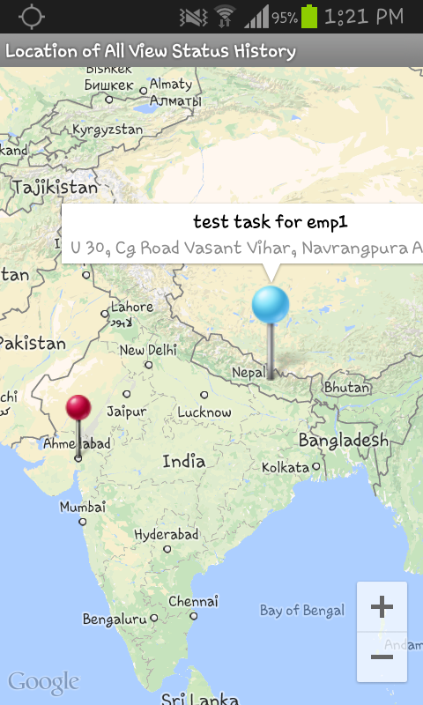
View Task Status History – View Map

Slide 27
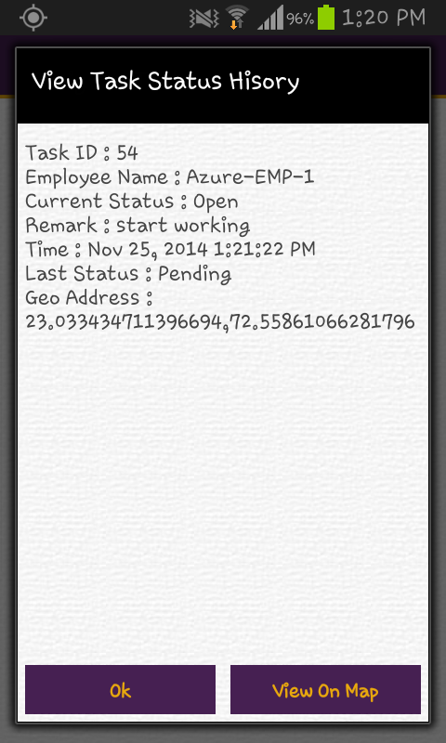
View Task Status History

Slide 28
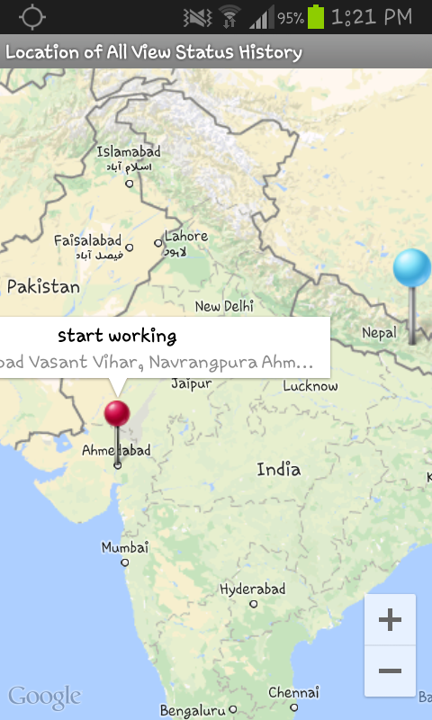
View Task Status History – View on Map

Slide 29
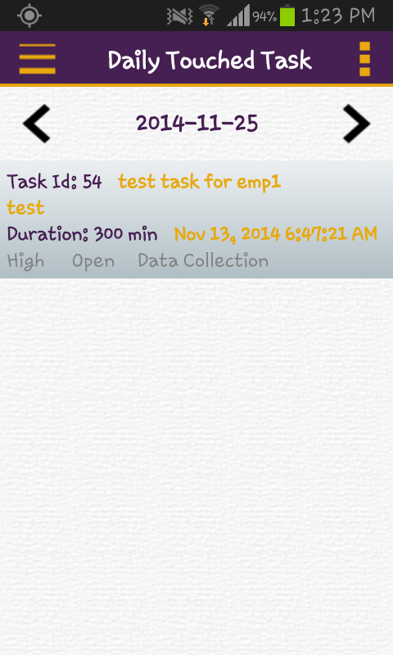
Daily Touched Task - List
List of Task on that Feedback given as well as Status change of task that should be appeared.

Slide 30
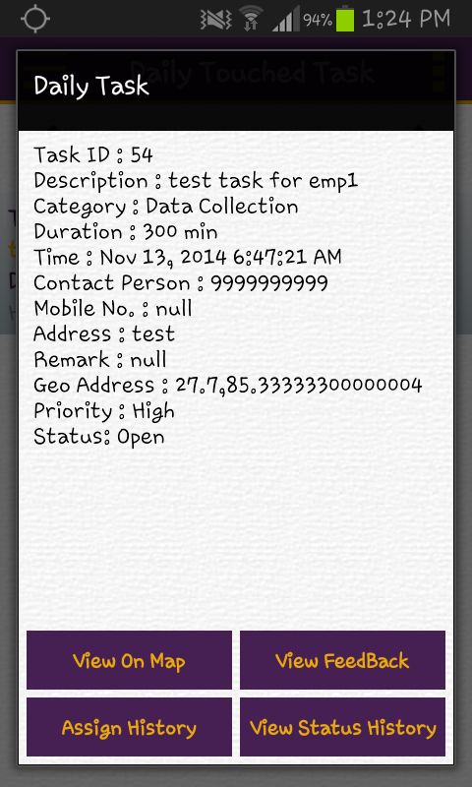
Daily Touched Task

Slide 31
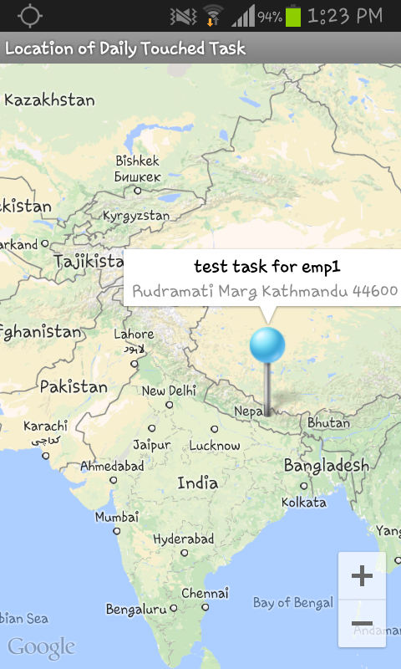
Daily Touched Task – View Map

Slide 32
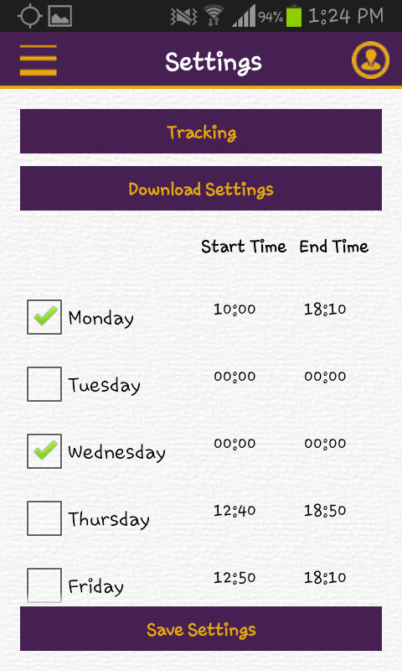
Settings
Tracking option will start the Tracking of Employee.
with its Last location, and accuracy in which speed employee should be travel.
List of week days employee should be travel with its start and end time
Changes will be saved afetr click on ‘save settings’.

Slide 33
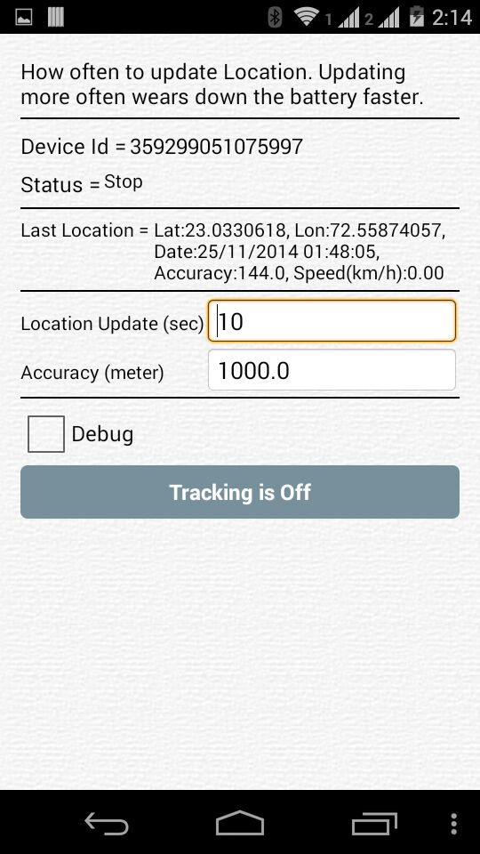
Settings - Tracking
Tracking On/Off will start or Stop.
Status will define the current state of tracking like Start or Stop.
with its Last location, Date and Time and accuracy in which speed employee should be travel.

Slide 34
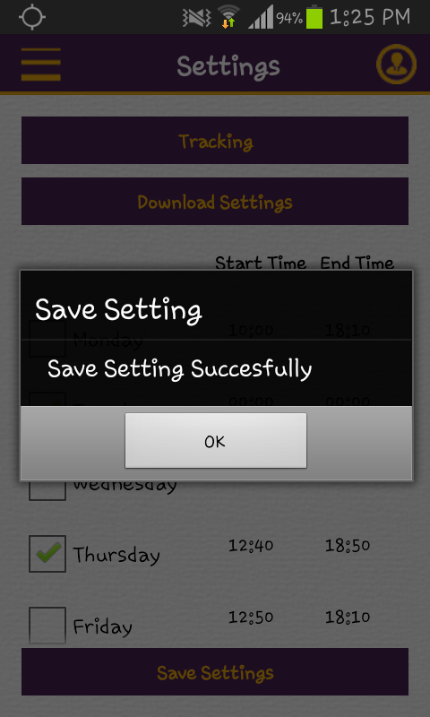
Settings - Save

Slide 35
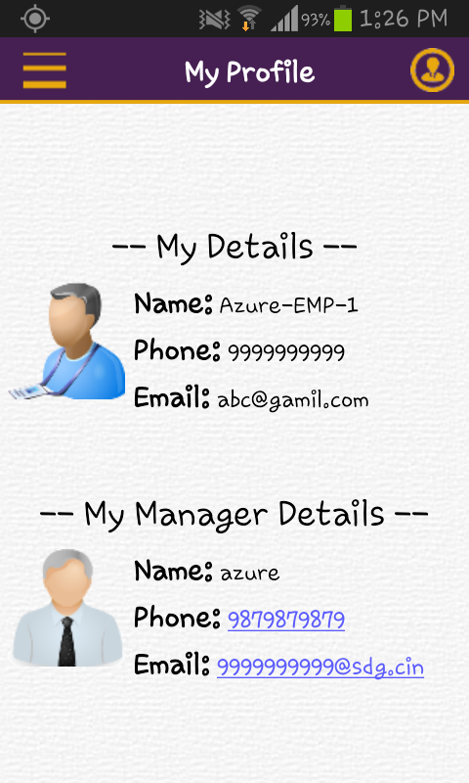
My Profile
Details of Employee as well as Manager should be shown.
Employee directly call as well as email to its manager from here.

Slide 36
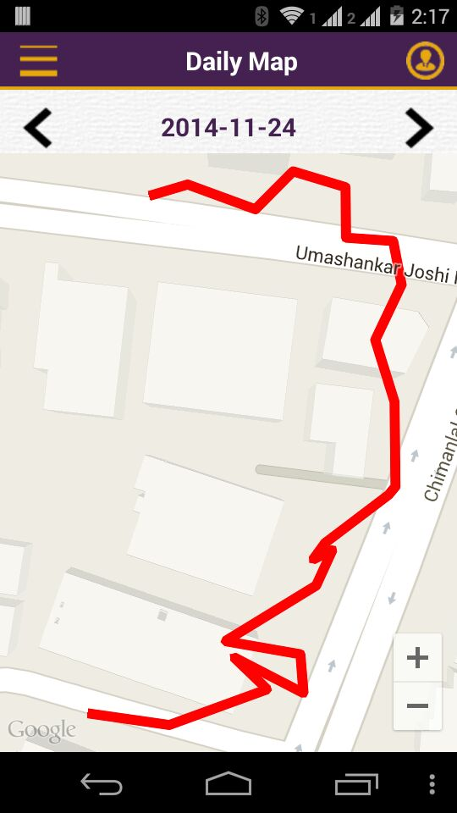
Daily Map
Daily Map show the Path that can be traversed perticular date.
Red line should be define the route path for employee.
date can be changed on above or click on the arrow to next and previous date.

Slide 37
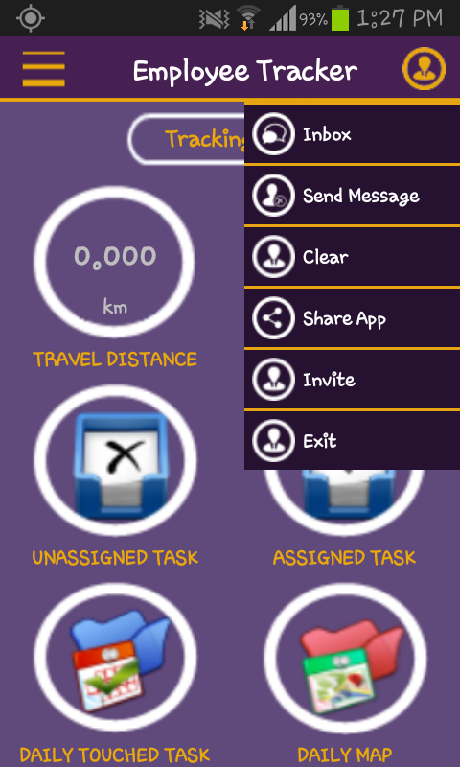
Menu

Slide 38
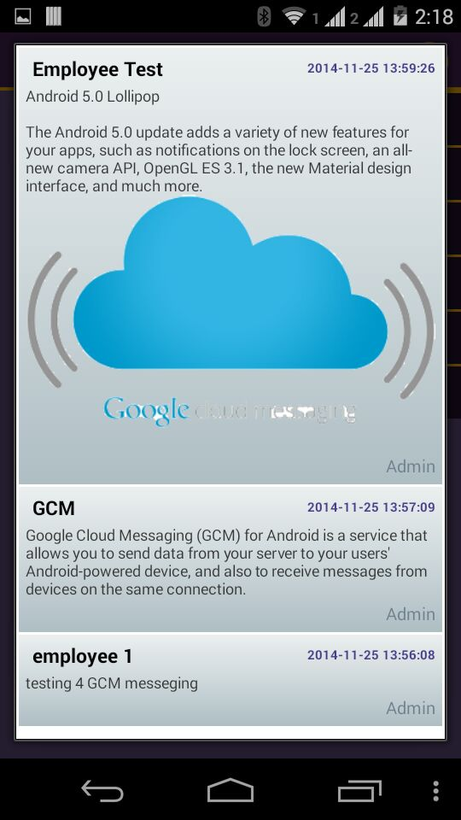
Inbox – GCM Messages
GCM messages should be placed over here.
List of Message displayed.
Messages can be Text as wll as Images displayed.

Slide 39
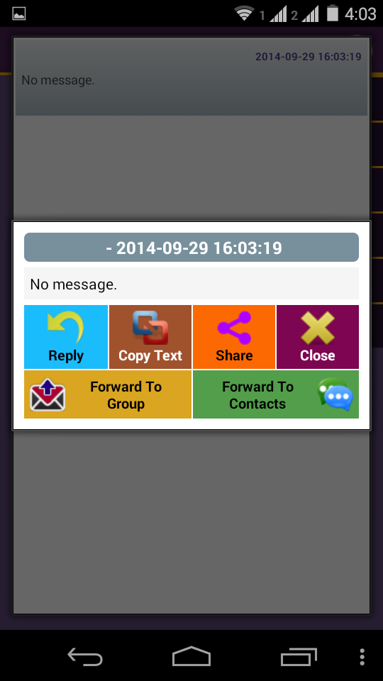
Inbox - Options
Options that can be performed on the inbox messages.

Slide 40
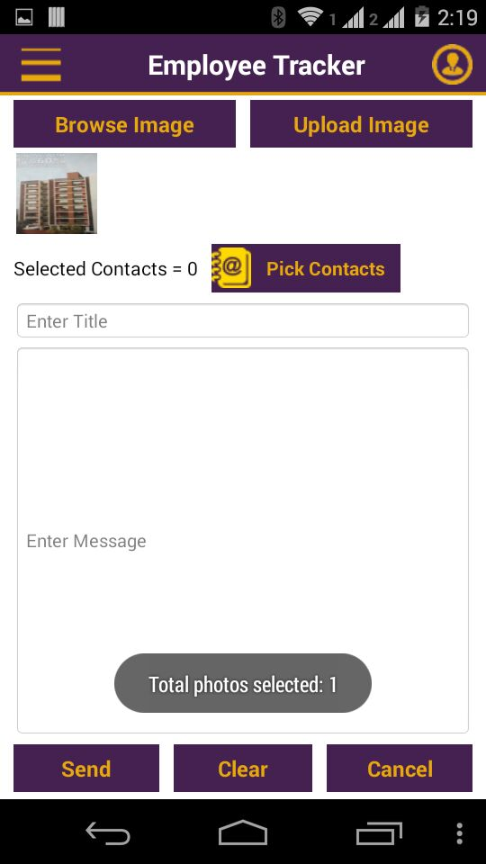
Send Message
Browse image fetch image from the gallary of device.
Upload image will upload on the server.
pick contact open the directory list of contact from whom want to send message
other function should clear the message and cancel to navigate the back.

Slide 41
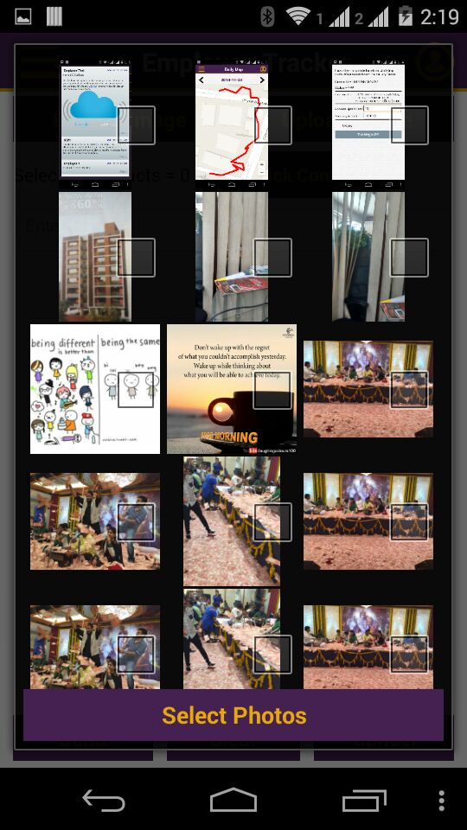
Browse Image

Slide 42
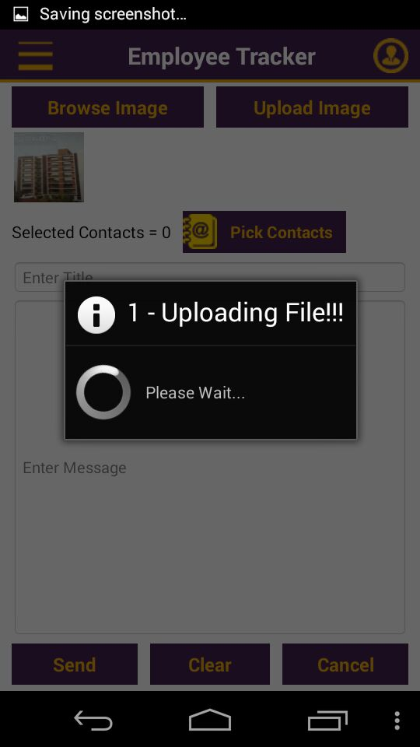
Upload Image

Slide 43
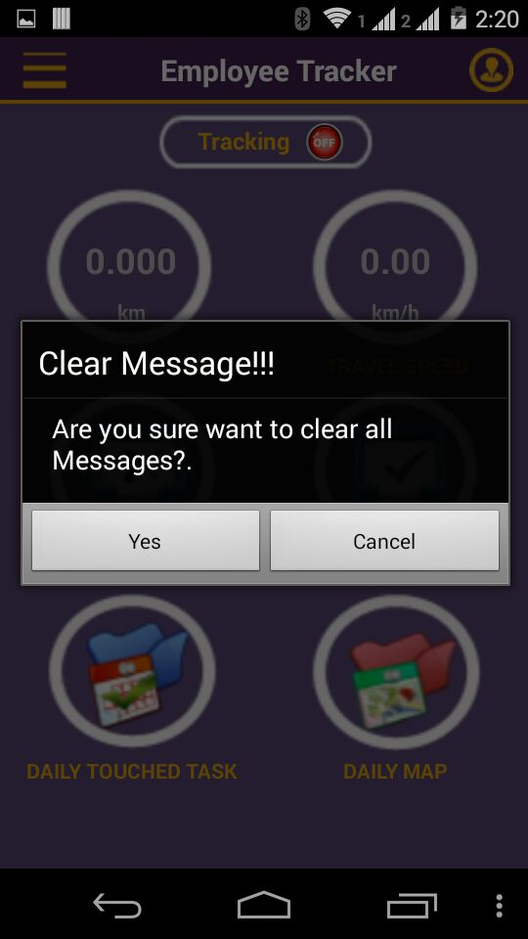
Clear
it Will clear the Inbox of Messages.
Dialog appear at the time of clear are you sure to
Perform the action if YES then clear it.

Slide 44
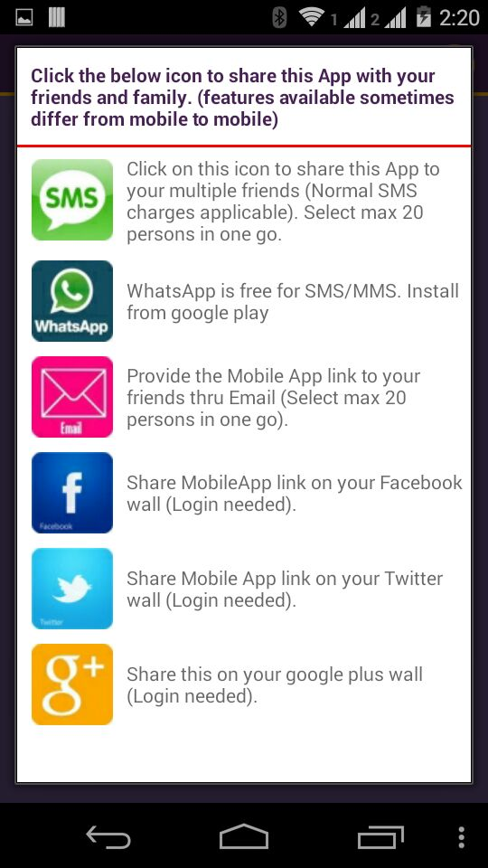
Share App
Share Application via Social Media Intigration.
Share with inbuilt Messaging App, WhatsApp, Email,
Facebook, Twitter and Google Plus.

Slide 45
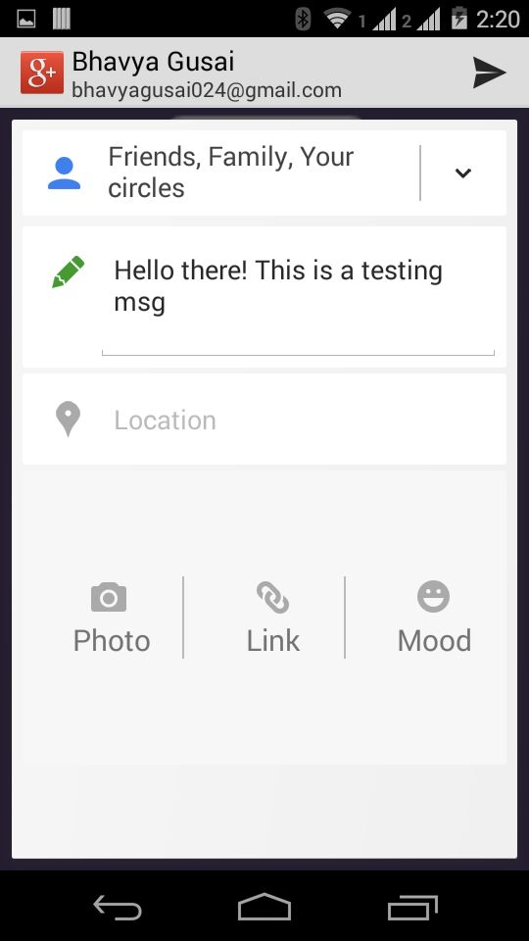
Share App with Google Plus

Slide 46
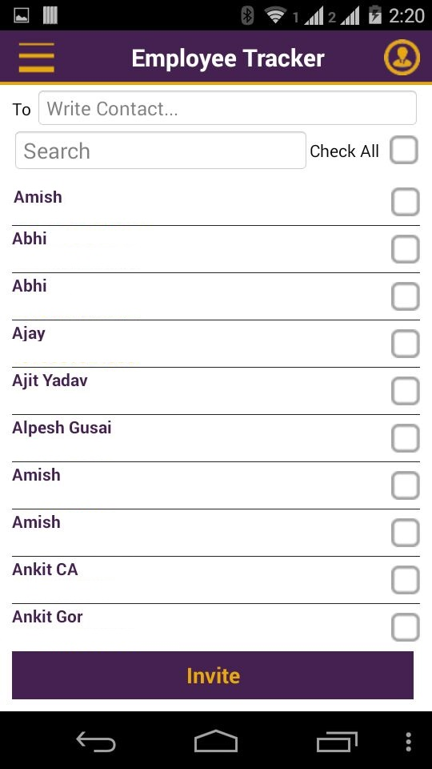
Invite
Invite to your contact list.
facility to select contact list friends and invite them.

Slide 47
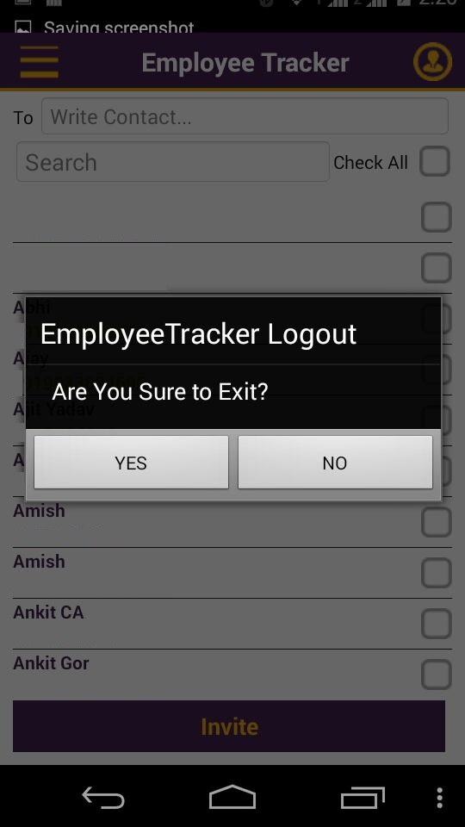
Exit
Exit will appear the dialog to perform the action.

